Slide 1
What was the USA’s birth rate between 1960 and 2015?
Chung-I Huang

Slide 2
Dataset
World Development Indicators Dataset

Slide 3
Motivation
To look into the birth rate trend between 1960 and 2015 in the USA.
Wondering how the birth rate correlated to the GDP.

Slide 4
Research Question(s)
Compared to other countries, does the USA have an outlier of birth rate?
To what happened, what associated to this change?
Can GDP be regarded as an important factor causing the change?

Slide 5
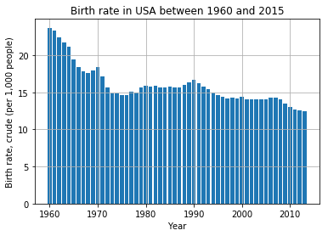
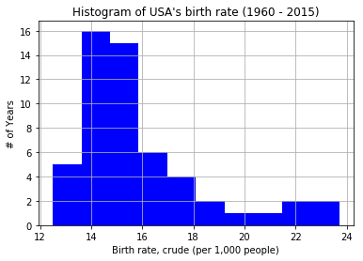
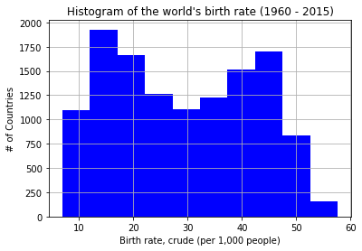
Findings
Fig. (a)
Fig. (b)
Fig. (c)
Between Fig. (a) and (b), we can see that after 1960, the birth rate decreases over times. The USA has many years where it has a birth rate between 13-15 (per 1,000 people).
In Fig. (c), the mean of the USA’s birth rate is ‘15.9’ during these years. Although the USA is not an outlier in this result (~1900 countries has about this birth rate), it is still quite low compared to other countries. The mean of the world’s birth rate is ‘29.25’.

Slide 6
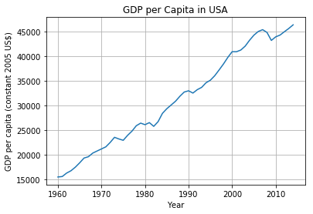
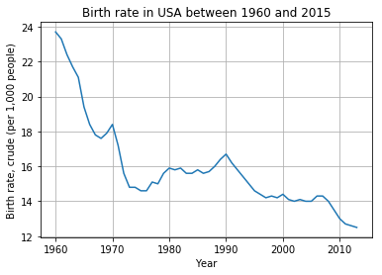
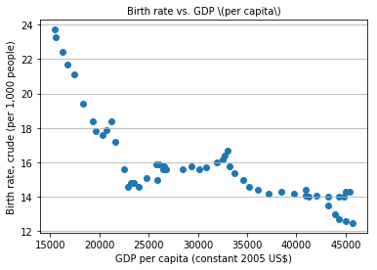
Findings
Fig. 1
Fig. 2
Fig. 3
With the Fig. (d) chart, we pull out the GDP vs. Years, you can see that the economy increased yearly; however, the birth rate in the Fig. (e) chart decreased between 1960 and 2015 in the USA. This drew my attention to figure out the correlation behind the results.
Therefore, the Fig. (f) chart came out. When we compare GDP vs. Birth rate, we noticed that the GDP is significantly correlated to the Birth rate, the correlation coefficient is -0.799. The result makes sense because once the economy becomes steady, the less the birth rate, as seen in most developed countries. Although I didn’t attach the bottom birth rate data here, I noticed that most of the low birth rate countries are the developed countries, such as Japan, Italy, Sweden, and so on.
*** These findings are limited to the data set so my results are reflective of this information only. ***

Slide 7
Acknowledgements
I will give 5 stars to this class. Even those who don’t have experiences in statistics and Python, they still are able to catch up in the courses by following the step by step contents. This makes me more confident in joining the data science field.

Slide 8
References
All my own work, I refer to Week 5 – Visualization class slides for most of the analyzation.

